Slide 1
Economic Policy and Business Activity
Chapter 4
Monetary policy

Slide 2
Topics covered in chapter 4 - Monetary policy
Brief historical overview
The objectives of monetary policy
What do central banks do?
Principles and theories underpinning monetary policy (the why)
Transmission channels underpinning monetary policy (the how)

Slide 3
Learning outcomes (#1)
Explain the emergence of a macroeconomic role for monetary policy
Explain how monetary policy is operated
Explain the main objectives of monetary policy
Explain the main functions of Central Banks (CBs)
Explain the difference between conventional and unconventional measures in the context of CBs monetary policy

Slide 4
Learning outcomes (#2)
Explain the different principles underpinning monetary policy, and respective underlying models and/or theories
Explain the principle of the long-run neutrality of money and its relation to the Quantity Theory of Money
Explain the reasons for the short-run disconnect between monetary growth and inflation (the existence of short-run nominal rigidities)
Explain the main transmission channels of monetary policy decisions and discuss how the strength of the various transmission channels may differ across countries
Explain the main justifications for the interdependence between monetary and fiscal policies in the long and short run

Slide 5
Monetary policy: Introduction
We can´t talk about MP without talking about money and Central Banks (CBs). Money is an old device, but the concept of monetary policy is relatively recent
The emergence of a macroeconomic role for monetary policy can be linked to two experiences: the hyperinflation of the 1920s and the subsequent Great Depression - both experiences have been shown to be related to monetary policy errors – excessive money creation in the 1920s and excessive money tightening in the 1930s
MP remained in the shadow of FP in the first post-World War II decades, and its importance only re-emerged as a consequence of the mistakes made in response to the inflationary shocks of the 1970s and the subsequent emergence of disinflation as a dominant policy objective and the decision to grant independence to central banks

Slide 6
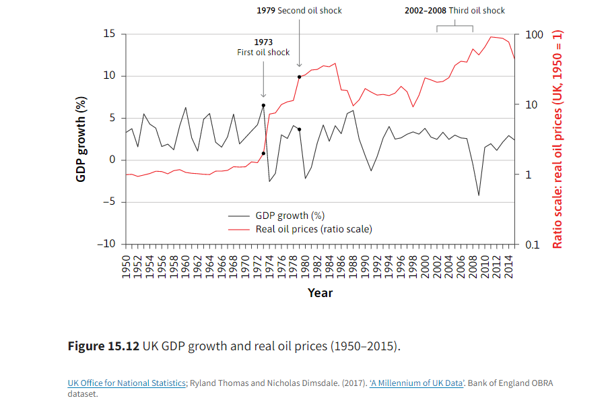
Monetary policy: Introduction
High inflation in the 1970s and early 1980s was associated with high unemployment in many countries.
Following the experience of rising inflation across the world, during the late 1980s there was a rethinking of how macroeconomic policy should be designed.
In the 1990s, the policy known as inflation targeting by central banks was widely adopted.
Two important features of the 1990s and 2000s prior to the 2008 financial crisis:
Monetary policy and Central banks were made independent of government control in most advanced and many developing countries.
Inflation targeting: Central banks used their policy instruments to keep the economy close to a target rate of inflation. [with some differences btw Fed vs. ECB]

Slide 7
Monetary policy: Introduction
The 2008-09 crisis challenged the traditional view of central banks.
Monetary policy quickly approached the zero bound.
Unconventional policy was adopted:
direct provision of liquidity to nonfinancial companies by buying short term securities (thus replacing regular banks in providing liquidity)
Credit (or quantitative) easing by buying government bonds in secondary markets.

Slide 8
1986 joins EU and 1999 Euroarea

Slide 9
To understand the workings of monetary policy and CBs role, we should consider the questions below and which economic theories and models have been used to answer them.
What is the relation between money, inflation, and unemployment?
How does it relate to the use of monetary policy (as opposed to fiscal policy) to stabilize employment and income?

Slide 10
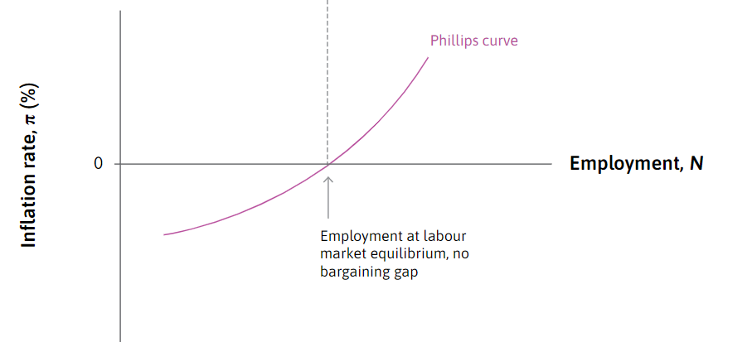
Inflation, unemployment, interest rate and monetary policy
The Phillips curve (1958) identified a trade-off between inflation and unemployment: when unemployment is low, inflation tends to rise. When unemployment is high, inflation falls.
There have been adjustments and revisions to the initial model, but the general idea of a trade-off was generalized until our days.
When central banks report their interest rate decision to the public, they normally justify a rise in the interest rate by saying that forecast inflation is up. They are raising the interest rate to dampen aggregate demand, raise cyclical unemployment, and as a result, bring inflation closer to the target.
Conversely, when CBs are announcing a lower interest rate, they explain that this is because there is a danger of inflation falling too low (possibly into deflation). Just as a reduction in aggregate demand and employment will bring inflation down, a rise in aggregate demand and employment will increase inflation.
Notes:
How the rate of unemployment and the level of output in the economy affect inflation, the challenges this poses to policymakers, and how this knowledge can support effective policies to stabilize employment and incomes

Slide 11
Money, money aggregates, and the money multiplier
Money can take many forms such as banknotes, deposits or assets. Various monetary aggreagates are defined, depending on the liquidity of the assets.
Money supply can be described using the money creation multiplier, which essentially assumes that money is exogenous to the economy.
M0 (or H) | money directly circulated by the central bank (coins and notes in circulation plus deposits of commercial banks at the central bank)
M1 | H + demand deposit accounts in commercial banks
M2 | M1 + deposits with a maturity of up to two years
M3 (or M) | M2 + money market instruments, i.e. marketable securities with less than one year to maturity
More liquid assets
Less liquid assets
Commercial banks create money via credit. The ratio of M3, M2, and M1 are called the money Multipliers. If they remain constant, control of M0 controls all aggregates. However, multipliers change over time and the M0 is not reliable.

Slide 12
Money, money aggregates, and the money multiplier
Historically, monetary aggregates (e.g. M1, M2) played an important role in monetary policy. In the 1980s, most central banks relied on such aggregates to guide policy: monetary aggregates served as leading indicators of future inflation because they were supposed to be strongly correlated with future inflation (as predicted by monetarists’ quantity theory of money)
CBs targeting low inflation would define a path for monetary aggregates consistent with price-stability objective. However, experiences with strict control of money aggregates, especially in the US and the UK in the late 1970s, resulted in high interest-rate instability, and money aggregates proved to be poor predictors of inflation in a financial-innovation context
Aggregates were thus put aside as policy indicators and some CBs (e.g. US FED) don’t publish them anymore

Slide 13
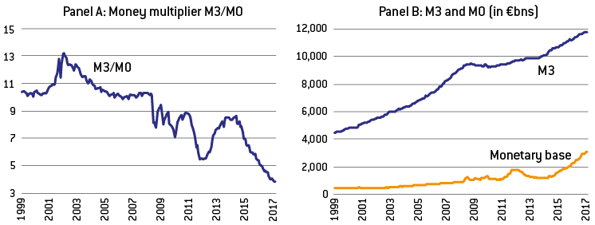
Monetary aggregates and money multiplier in the euro area since 1999:
Since 2007 the multiplier has fallen considerably.
The increase in M0 during the crisis has not led to a proportional increase in M3, nor has the ECB’s 2012 decision to cut by 2 the reserve requirement led to a doubling of broad money M3 through quicker expansion of credit in the euro area
Source: http://bruegel.org/reader/How_should_ECB_normalise_its_monetary_policy#defining-the-new-normal

Slide 14
Liquidity provision by Central Banks
So far we have seen that despite CBs have the privilege of creating base money, the majority of money is created through credit provided by commercial banks. Commercial banks create money by providing loans, i.e., there is money creation each time the banking sector extends a loan to nonbank customers, because this amounts to increasing the total amount of deposits in the system
The provision of liquidity to the banking and financial system is more important and relates directly to CBs role of ensuring a safe payment system and a stable price of liquidity. The main aims of MP, to be enforced by CBs, are to maintain price stability and promote a safe and efficient payment system.
CB’s determine the provision of liquidity in three ways
  By setting the value of the legal reserve requirement for commercial banks
  Through the setting of reference interest rates (official ‘policy rates’) to influence the interest rate in money markets
  Through open market operations, which influences directly market liquidity and signals CB’s MP strategy

Slide 15
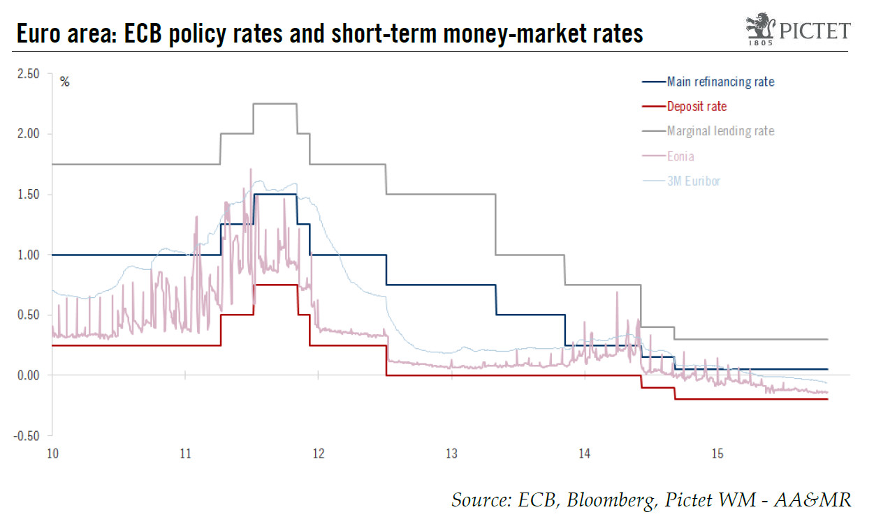
EONIA (Euro Overnight Interest Average) is the money market rate as the average of interbank lending (similar for Euribor at longer maturities).
ECB interest rates (the MLR and the DR set the ceilings and floor to the money market rates):
rate on the main refinancing operations (MRO), which provide the bulk of liquidity to the banking system
rate on the deposit facility, which banks may use to make overnight deposits with the Eurosystem
rate on the marginal lending facility, which offers overnight credit to banks from the Eurosystem
Notes:
ECB has three reference interest rates
The interest rate on the main refinancing operations (MRO), which provide the bulk of liquidity to the banking system.
The rate on the deposit facility, which banks may use to make overnight deposits with the Eurosystem.
The rate on the marginal lending facility, which offers overnight credit to banks from the Eurosystem.

Slide 16
Liquidity provision by Central Banks
In the euro area, the main refinancing rate (or refi) is complemented by two marginal financing rates that set a ceiling and a floor to market-rate fluctuations. These rates are sometimes called leading interest rates because they lead the market interest rate. See ECB’s page with policy interest rates: https://www.ecb.europa.eu/stats/policy_and_exchange_rates/key_ecb_interest_rates/html/index.en.html
Every day the ECB measures the average of interbank rates in the money-market, which is called the EONIA (Euro Overnight Interest Average), from a panel of euro area banks. The EONIA fluctuates around the refi rate. After 2021, the EONIA was replaced by the Euro Short Term Rate.
The ECB reference interbank rate for longer periods (1 week to 1 year) is known as EURIBOR (Euro Interbank Offered Rate) and determines interest rates operated by commercial banks on loans to firms and households. Every day the ECB measures the average of the EURIBOR for the different maturities (1week, 2 weeks, 1 month,…, 1 year)

Slide 17
The role of Central banks in monetary policy
By the late 1990s, a near-consensus was achieved that monetary policy should be geared towards price stability. After the recent financial crisis of 2008, there was an additional effort from central banks both to convey and make certain their role of guarantors of financial stability
The dramatic worsening of the economic situation in the aftermath of the 2008 financial crisis led MP to change the conventional course; this was reinforced with the covid-19 pandemic
CBs unconventional measures included, beyond short-term lending to banks, two main initiatives:
  direct provision of liquidity to nonfinancial companies through the purchase of short-term securities as a result of the paralyzed banking system
  credit easing or quantitative easing by buying longer-term securities such as government bonds in order to keep the asset market operating and lower longer-term interest rates
One of the most relevant aspects of the evolution of monetary policy is its increasing sophistication and the growing importance of credible communication and transparency of CBs to market participants and private agents (rules-based approach to avoid time-inconsistency)

Slide 18
Liquidity in stress times
In normal times banks extend credit to each other, and CB “only” monitors the process and influences interest rates through the provision of limited liquidity to the banking system
However, when banks are unwilling to lend to each other - e.g. because potential lenders are uncertain of the ability of the borrowers to repay their debts, or because they themselves prefer to hoard cash in anticipation of future shortages -, CBs need to intervene in order to prevent liquidity crises (i.e. to ensure financial stability)
Liquidity crises tend to be caused by financial shocks. A revealing example was the US subprime credit crisis with initial signs apparent in summer 2007, causing fear that major banks would face funding problems and even bankruptcy. The result was a decline in the interbank liquidity provision because commercial banks were not lending to each other.
More recently, Covid19 has also created a liquidity crisis.

Slide 19
4.1.2 The objectives of monetary policy
Price stability
Exchange-rate stability
Output stabilization
Financial stability

Slide 20
4.1.2 The objectives of monetary policy
The objectives that CBs should pursue constitute their mandate; they have varied over time and are still a matter of discussion among politicians and economists
One of the lessons drawn from the inflation of the 1970s and the 1980s has been that central banks ought to be given more precise objectives; price stability emerged as the dominant one
However, not all CBs have a mandate focused on price stability and those that do may have to pursue other objectives simultaneously
The financial crisis of 2007-09 opened a discussion on whether CBs should be less focused on controlling price inflation and gear monetary policy more towards financial stability

Slide 21
4.1.2 The objectives of monetary policy
Price stability
Exchange-rate stability
Output stabilization
Financial stability
I will talk about 1) and 4) first

Slide 22
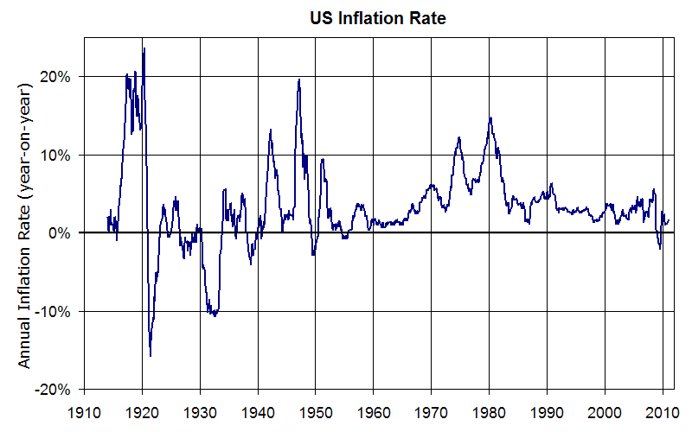
4.1.2 The objectives of monetary policy
1. Price stability

Slide 23
4.1.2 The objectives of monetary policy
1. Price stability

Slide 24
4.1.2 The objectives of monetary policy
1. Price stability
Pursuing price stability consists of maintaining the real value of money, i.e. its purchasing power: the quantity of goods, services or assets that one unit of money can buy.
The most frequently mentioned benefit of price stability is that inflation distorts economic decisions through the implicit taxation of cash balances and it blurs relative price signals, thus affecting the allocation of resources in an economy
Money-created inflation is also associated with Cantillon effect, which essentially says that inflation is a regressive tax, as it transfers wealth from creditors to debtors and represents a greater loss of income for lower income households
This is why most central banks aim at keeping the inflation rate at a low value

Slide 25
4.1.2 The objectives of monetary policy
1. Price stability
Are central banks best placed to reach the price-stability objective?
The monetarist answer: “inflation is always and everywhere a monetarist phenomenon”, pointing to a direct causal relation between quantity of money and inflation
This proposition implies that price stability requires controlling the amount of money in circulation and makes monetary policy the natural instrument for controlling inflation
However, the medium-term direct relationship between money and prices has broken down in recent times, and contemporary economic models do not give a special role to money (i.e. money aggregates)
There must therefore be other justifications for assigning the control of inflation to monetary rather than to fiscal policy

Slide 26
4.1.2 The objectives of monetary policy
1. Price stability
Are central banks best placed to reach the price-stability objective?
The arguments are both economic and institutional:
assumption of long-term neutrality of money, i.e. the disconnection, in the long run, between nominal variables and real variables. Though it has real effects in the short run, over a long horizon, monetary policy can best control nominal variables without affecting real variables. This is not the case for fiscal policy, which affects the composition of output both in the short run and in the long run
controlling inflation should not be distracted by other policy objectives that may influence the price level, such as output targeting or the financing of public deficits. Independent institutions with a narrow mandate are better equipped to do this
For these reasons, CBs have been put in charge of price stability in almost all countries

Slide 27
4.1.2 The objectives of monetary policy
1. Price stability
Disinflation was a major achievement of the 1990s
Some debate remains with respect to how much of the price stability observed in the 1990s and the early 2000s was due to
  1) favourable worldwide conditions associated with globalization (positive supply shock), and/or
  2) how much to the quality of monetary policies and institutions (institutional developments) is hard to tell
The answer is most likely the two

Slide 28
4.1.2 The objectives of monetary policy
4. Financial stability
Financial stability - i.e. the proper functioning of banks and financial markets - was not a major concern in the post Great Depression financial systems of the 1960s
However, after the progressive liberalization of the financial systems in the 1980s and the 1990s, the issue gained prominence with the emergence of the worldwide financial crisis that started in 2007-08
Responsibility for financial stability is generally shared between regulatory agencies that deal with one or several specific market segments (such as securities, banking, insurance, etc.), the central bank, and the finance ministry.

Slide 29
4.1.2 The objectives of monetary policy
4. Financial stability
In general, the responsibility of regulators and supervisors is microeconomic in nature whereas the central bank’s is macroeconomic
The micro-financial framework involves setting standards to ensure that banks properly manage the risks they take and hold sufficient capital to cover them. This is the role of prudential policy, it is a necessary condition for financial stability but is not sufficient: even sound financial systems are subject to bubbles!
A safe banking and financial sector is crucial for MP transmission and CBs are very concerned by financial stability. This can lead CBs to extend large amounts of liquidity to the banks in the short run when all of them are simultaneously seeking liquidity, and therefore cannot lend to each other

Slide 30
4.1.2 The objectives of monetary policy
4. Financial stability
The reason why central banks are willing to provide liquidity to markets in times of stress is that events that endanger the ability of some borrowers to meet their obligations may degenerate into a chain reaction – what is called a systemic crisis
The financial stability role of the CBs raises three policy issues which are a matter of ongoing discussion:
(1) Moral hazard
(2) Compatibility with price stability
(3) Implications for the definition of central bank objectives

Slide 31
4.1.2 The objectives of monetary policy
4. Financial stability
1) Moral hazard
By acting as a lender of last resort that extends assistance to important financial institutions when they find themselves unable to raise money on the market, CBs may encourage imprudent risk-taking behaviour.
Furthermore, the collateral provided by illiquid financial institutions in the context of repurchase agreements may be of inferior quality, which may imply that the CB de facto engages in implicit bail-out

Slide 32
4.1.2 The objectives of monetary policy
4. Financial stability
2) Compatibility with price stability
In principle, the provision of liquidity by CBs in times of stress should not conflict with their macroeconomic objectives, in particular, price-stability
This is likely true when assistance is provided to one particular institution, but less so when CBs engage in wholesale liquidity provision like in the aftermath of the crisis of 2007-09. In such situations, loans to banks increase the quantity of money that could result in inflation if extended beyond the liquidity stress period

Slide 33
4.1.2 The objectives of monetary policy
4. Financial stability
3) Implications for the definition of central bank objectives
Central banks monitor asset prices as these convey information on possible future crisis and on possible developments in inflation. In particular, a rise in asset prices may lead to imprudent borrowing and their eventual fall may result in financial disturbance. However, in general, the control of asset prices has not been assigned to central banks’ objectives
None of the three issues can be considered settled definitively. The role of CBs was once defined in a context where commercial banks were the main actors in the collection of savings and the allocation of financial resources, but traditional models are being challenged by the development of market-based finance, disintermediation, and the development of financial innovation

Slide 34
4.1.2 The objectives of monetary policy
2. Exchange rate stability
An historically important role of monetary policy has been exchange-rate stability, i.e. the external value of a currency
Until the 1990s, many countries relied on a fixed exchange rate as a means of controlling inflation and, after the demise of the Soviet bloc, several countries in transition decided to “anchor” their economy through the setting of a fixed exchange rate
However, the attraction of fixed exchange-rates has faded away in recent years, though China and some smaller countries continue to peg their exchange rates (i.e. their currency external-value)

Slide 35
4.1.2 The objectives of monetary policy
3. Output stabilization
Like fiscal policy, monetary policy has a short-run impact on aggregate demand.
This is because in the presence of price rigidities a lower interest rate tends to encourage investment (through a lower real interest rate) and net exports (through a depreciated real exchange rate), and because higher prices reduce the purchasing power of those assets, like conventional fixed-rate bonds, that are not perfectly indexed to inflation
Monetary policy can therefore be used to stabilize aggregate demand, i.e. support demand through an expansionary monetary policy when demand is weak and a restrictive monetary policy when demand is ballooning

Slide 36
4.1.2 The objectives of monetary policy
3. Output stabilization
The rationale for counter-cyclical MP goes back to the Great Depression of the 1930s but, as for FP, the desirability and effectiveness of counter-cyclical MP are debated
The existence of price rigidities, a hypothesis upon which counter-cyclical monetary policy relies, is not much debated anymore
However, the long and variable lags involved in the transmission of MP impulses make the discretionary stabilization a delicate exercise which can transform a counter-cyclical policy into a pro-cyclical one. This is why the degree of central bank activism is a matter for discussion
Market expectations may also impede counter-cyclical policy through the adjustment of long-run interest rates. E.g., long-run interest rate may increase in a recession if short-term rates are lowered aggressively and are expected to lead to future inflation

Slide 37
4.1.2 The objectives of monetary policy
3. Output stabilization
CBs behave in practice as if they were aiming at minimizing the output gap. In 1993, John Taylor showed that the average reaction of the Federal Reserve to US inflation and the output gap could be captured by the Taylor Rule:
where $i_{t}$ is the short-term nominal interest rate, $π_{t}$ the inflation rate, $\tilde{π}$ the inflation objective, ($y_{t}−{\tilde{y}}_{t}$) the output gap, $\tilde{r}$ the “neutral” level of the real interest rate (equal to the growth rate of the economy, which maximizes consumption per capita at the steady state according to the golden rule of growth theory)
Essentially, the Taylor rule sets interest rates based on current inflation and the gap between actual and potential output (i.e. output gap)
$$\left.i_{t}=\tilde{r}+π_{t}+0,5\left(π_{t}−\tilde{π}\right)+0,5(y_{t}−{\tilde{y}}_{t}\right)$$

Slide 38
4.1.2 The objectives of monetary policy
3. Output stabilization
The Taylor rule has become one of economists’ basic tool to assess interest-rate variations. The Taylor rule is a useful standard for comparing monetary instances over time and across countries
The fact that CBs appear to react to the output gap does not imply that they have an output-stabilization objective
The output gap can be viewed as a measure of excess supply of goods and services in the economy, and thus can be used as a predictor of future inflation. Raising the interest rate is the appropriate reaction to curb future inflation when demand exceeds potential output, even for a CB that does not pursue output stabilization per se

Slide 39
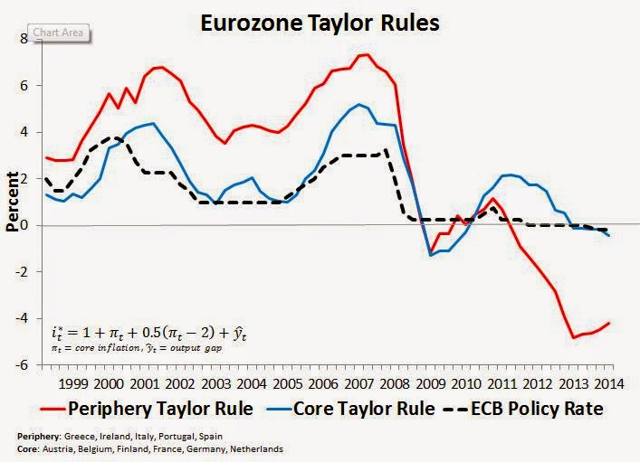
4.1.2 The objectives of monetary policy
3. Output stabilization
Essentially, the Taylor rule sets interest rates based on current inflation and the gap between actual and potential output (i.e. output gap)
Indicates a pattern of the ECB setting its interest rate target in a manner more consistent with the core economies
Monetary policy was too tight in 2008-2009 for both periphery and core regions
Afterwards it was too tight for the periphery, suggesting the second stage of crisis was a regional monetary policy crisis localized to the periphery
http://macromarketmusings.blogspot.pt/2015/03/the-origins-of-eurozone-monetary-policy.html

Slide 40
4.1.2 The objectives of monetary policy
Summary:
Of the four objectives only the first (price stability) is formally included in all CBs mandates
Financial stability is a core objective of most CBs, though not necessarily explicitly
The other objectives may or may not feature among the goals of the monetary institutions.
See Table

Slide 41
Many governments have given responsibility for monetary policy—often described as inflation targeting—to central banks, rather than fiscal policy
Why?

Slide 42
How do monetary and fiscal policies relate to each other, are they interdependent?
Independence of monetary policy from fiscal policy is only possible if fiscal policy is sustainable or if the central bank is indifferent to the risk of government bankruptcy
If public debt ratio exceeds its sustainable long-run level and fiscal authorities refrain from undertaking a fiscal retrenchment, asset holders will anticipate:
government default. In this case the CB may be hurt by the loss of value of its assets. More importantly there will also be economic consequences relating to commercial bank defaults
debt monetization (i.e. CB bails out the government through a massive purchase of its bonds and raises money supply accordingly), with its inflationary consequences

Slide 43
How do monetary and fiscal policies relate to each other, are they interdependent?
The long-run interdependence between fiscal and monetary policy implies that lasting monetary stability is very unlikely if the fiscal authority behaves in irresponsible ways
The long-run interdependence is the main justification for limiting public borrowing in a monetary union (as discussed in Chapter 3)
In the short run, there is no consensus on the desirability of coordinating monetary and fiscal policies to achieve a policy-mix, at least as long as monetary policy remains effective
Opponents of coordination point out that coordination can threaten CBs independence and argue that the rivalry between monetary and fiscal policy can be solved by making monetary policy fully independent
Specific coordination issues arise when monetary policy reaches the zero bound on nominal interest rates and embarks on unconventional policies. The ZLB introduced a new kind of monetary policy called quantitative easing (QE). The aim of QE is to increase aggregate demand by buying assets, even when the policy interest rate is zero.

Slide 44
Principles and theories underpinning monetary policy (the why)
The long-run neutrality of money
Short-run nominal rigidities
Optimal interest-rate setting
Central bank credibility
Are monetary and fiscal policies interdependent?

Slide 45
Theories about money demand and supply
Monetary policy is a very active field of research, where theory has had major influence on the design of policy institutions and workings of monetary policy
In the 1960s and 1970s, the monetarists challenge to conventional Keynesian wisdom emerged from what was initially a critique of monetary-policy practices, notably through the rational expectation models
Views on the demand for money: Keynes theory on the preference for liquidity (for transactions; precaution; speculation) vs. monetarist theory
According to Monetarist theory, the demand for money would be relatively stable and weekly sensitive to change sin the interest rate, meaning that the control of money supply was a stronger determinant of aggregate spending -> CBs should control the supply of money (through interest rate and minimum reserves requirement) in order to stabilize prices and economic cycle. NB! This assumes that money is exogenous to the economy, but we have seen that in reality this is not entirely true.

Slide 46
The long-run neutrality of money
“neutrality of money” in the sense that changes in the quantity of money cause a proportional change of prices of goods, leaving the relative prices of goods unaffected
Quantity Theory of Money (QTM) is the simplest model consistent with this theory:
where P is the general price level, Y the real GDP, M the money supply, V is the velocity of circulation of money (i.e. number of times one unit of money is spent to buy goods and services over a given year).
Assuming V is constant or evolves at a constant rate independent of monetary policy, if the CB can control the growth of M, then, for a given GDP growth and a evolution of V, it can also control inflation:
PY = MV
∆P/P=∆V/V + ∆M/M - ∆Y/Y
(the general price level of goods and services is proportional to money supply)

Slide 47
The long-run neutrality of money
So: according to the QTM, the definition of a monetary policy target requires estimating growth of potential output and the trend evolution of monetary velocity. The monetary target then follows
The ECB in 1999 used the QTM to define the first pillar of its monetary strategy. For an inflation of 1,5%, it targeted money-supply growth at 4.5% a year, assuming a 2.5% real GDP growth in the euro area and a decrease of velocity by 0.5% a year:
In this approach, the monetary aggregate plays the role of an intermediate objective that is easily observable and more under the control of the CB than the final objective of price stability, yet whose evolution is a good predictor of the final objective
1.5% = - 0.5% + 4.5% - 2.5%

Slide 48
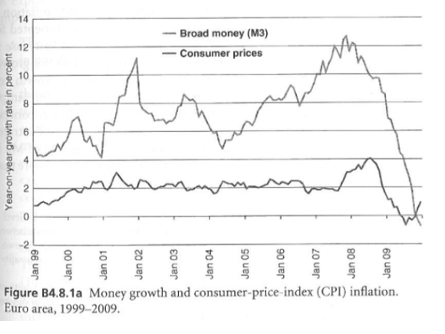
The long-run neutrality of money
In 2003, the ECB decided to downplay this first pillar because money growth had been continuously higher than the target without any major consequence for inflation (see Figure B4.8.1a)

Slide 49
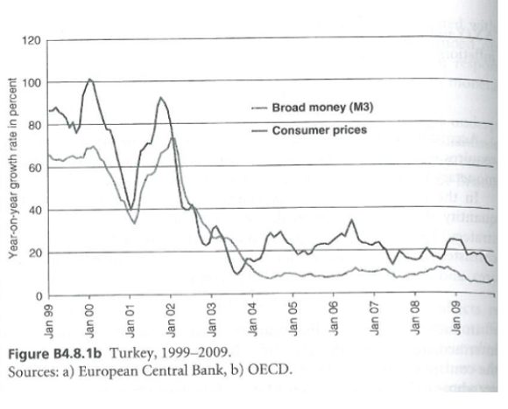
The long-run neutrality of money
Note that the link between money supply and inflation remains robust in high-inflation but not in low-inflation (see Figure B4.8.1b).

Slide 50
2. Short-run nominal rigidities
There is some disagreement on the validity of the QTM in the short run. One key explanation for the short-run disconnect between monetary growth and inflation is the existence of nominal rigidities, that is, the fact that following a shock on the supply of money, prices and wages adjust less than fully in the short run (think Keynesians)
Therefore, a rise in money supply increases the real value of monetary holdings, which affects other real variables, including the real interest rate and consumption

Slide 51
4.2.1 Principles underpinning monetary policy
2. Short-run nominal rigidities
For Keynesians, thus, the QTM may be valid in the long run but not in the short term. Changes in money supply affect first interest rates, which impact on the real economy (investment, employment, output) and then also prices
Hence, in the Keynesian framework, money-market equilibrium is achieved in the short run through nominal and real interest-rate adjustment rather than through price adjustment
In Keynes’s General Theory, a rise in money supply leads to
  in the short run to a fall in the interest rate. A lower interest rate encourage private agents and stimulates the demand for goods and services. If there is excess production capacity, GDP rises
  in the longer run, however, prices increase, bringing the interest rate and GDP back to their initial values

Slide 52
4.2.1 Principles underpinning monetary policy
2. Short-run nominal rigidities
In summary, the short-run impact of monetary policy on real variables such as output or employment relies on incomplete price adjustment, that is, the existence of nominal rigidities (i.e. wages and prices adjust slowly)
The existence of short-term nominal rigidities is not incompatible with the long-term neutrality of money: a monetary expansion will have an impact on real variables in the short run, but this effect will gradually be phased out by price adjustment

Slide 53
4.2.1 Principles underpinning monetary policy
3. Optimal interest-rate setting
You already know that CBs’ main monetary responsibility is to decide on the level of their interest rate(s) - But what should guide this decision?
In the 1960s the response to this question was largely ad hoc and discretionary
Then the monetarist revolution of the 1970s and the 1980s advocated for setting interest rates at a level consistent with the desired path for the monetary aggregates
However, as we saw before, the link between money growth and inflation has proved to be loose, at least in the short run. In addition, financial liberalization and financial innovations have made the control of monetary aggregates difficult

Slide 54
4.2.1 Principles underpinning monetary policy
3. Optimal interest-rate setting
CBs have started looking for an alternative strategy, new models of monetary policy have been developed in which monetary aggregates play a secondary role, or are altogether ignored
One example is the “new Keynesian” theory of monetary policy, which proposes the CB sets the short-term interest rate so as to keep the future inflation rate and the future output gap as close as possible to its targets (optimal Taylor rule)
In this model, the CB adopts a forward-looking approach. That is, it does not seek to control the current inflation or output gap but only their expected values. This implies the true objectives are the forecasts for inflation and for the output gap (because delays in the monetary-transmission mechanisms do not allow the central bank to control current variables)

Slide 55
4.2.1 Principles underpinning monetary policy
4. Central bank credibility
This refers to the problem of time inconsistency (see chapter 2) and inflation bias, and has been used as an argument for the independence of CBs
The use of discretionary MP by politically controlled CBs means they may use expansionary monetary policies for political reasons (e.g. re-election), and thus not appropriately aligned to output and unemployment levels. This can lead to anticipated inflation expectations such that in the long term output and unemployment remain at the same level (long-run money neutrality)
This is called an inflation bias: the CB mistakenly or intentionally targets a higher level of natural output (i.e. positive output gap) in order to reduce unemployment, leading to inflation above the optimal level.

Slide 56
4.2.1 Principles underpinning monetary policy
4. Central bank credibility
The credibility of the central bank can be defined as its ability to stick to its own policy announcements (“say what they do and do what they say”). Credibility is undermined by the problem of time-inconsistency (see chapter 2)
To make them effective in terms of optimal achievements, CBs need to commit to monetary rule(s). One popular monetary rule is inflation targeting, where the CB targets the average expected inflation rate over the next one or two years
Another monetary rule, especially in developing countries, is a fixed exchange-rate regime, where the CB commits to intervene so as to keep the nominal exchange rate stable
For the credibility of the CB, it is also important to embrace a long horizon, which implies long mandates and independence from politicians bound by the election

Slide 57
4.2.1 Principles underpinning monetary policy
4. Central bank credibility
In summary, to enhance credibility, most modern CBs combine:
  a mandate to achieve price stability,
  formal independence from the government, guaranteed by law (e.g. ECB independence is part of the EU treaty),
  long mandates, and
  a commitment scheme such as inflation targeting

Slide 58
4.2.1 Principles underpinning monetary policy
5. Are monetary and fiscal policies interdependent?
In the long run, independence of monetary policy from fiscal policy is only possible if fiscal policy is sustainable or if the central bank is indifferent to the risk of government bankruptcy
If public debt ratio exceeds its sustainable long-run level and fiscal authorities refrain from undertaking a fiscal retrenchment, asset holders will anticipate:
government default. In this case the CB may be hurt by the loss of value of its assets. More importantly there will also be economic consequences relating to commercial bank defaults
debt monetization (i.e. CB bails out the government through a massive purchase of its bonds and raises money supply accordingly), with its inflationary consequences

Slide 59
4.2.1 Principles underpinning monetary policy
5. Are monetary and fiscal policies interdependent?
The long-run interdependence between fiscal and monetary policy implies that lasting monetary stability is very unlikely if the fiscal authority behaves in irresponsible ways
The long-run interdependence is the main justification for limiting public borrowing in a monetary union (as discussed in Chapter 3)
In the short run, there is no consensus on the desirability of coordinating monetary and fiscal policies to achieve a policy-mix, at least as long as monetary policy remains effective
Opponents of coordination point out that coordination can threaten CBs independence and argue that the rivalry between monetary and fiscal policy can be solved by making monetary policy fully independent
Specific coordination issues arise when monetary policy reaches the zero bound on nominal interest rates and embarks on unconventional policies (e.g. buying govt bonds)

Slide 60
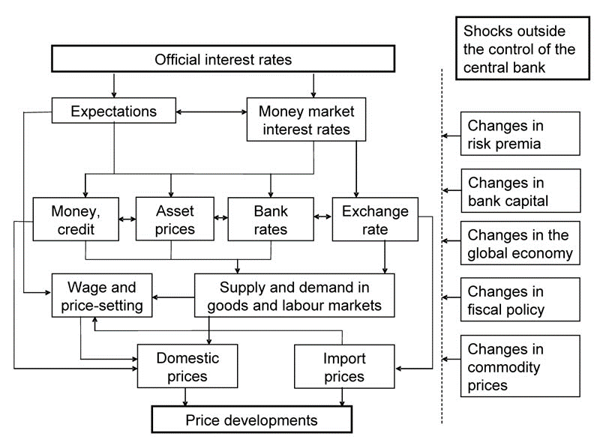
4.2.2 Transmission channels of monetary policy (the how)
Illustration of the main transmission channels of monetary policy decisions
The interest-rate channel
The asset-price channel
The credit channel
Source: https://www.ecb.europa.eu/mopo/intro/transmission/html/index.en.html

Slide 61
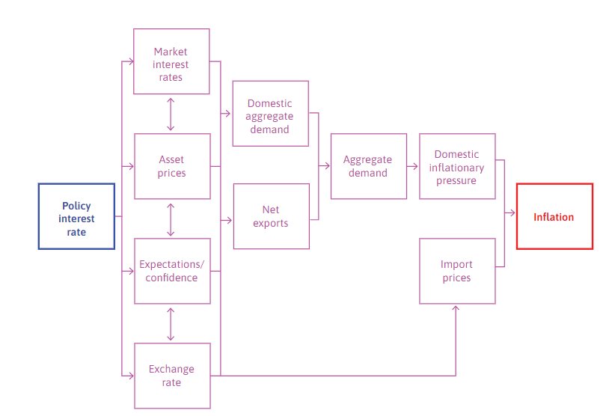
The transmission of monetary policy, e.g. Bank of England
Under the policy of inflation targeting, when unemployment is below the inflation-stabilizing rate, the central bank raises the interest rate and dampen aggregate demand.
Similarly, following a fall in aggregate demand and the threat of recession, the central bank would cut the interest rate and bring the economy back toward its inflation target.
? Why make central banks independent and give them inflation targets?
Source: https://www.core-econ.org/the-economy/book/text/15.html#158-monetary-policy

Slide 62
4.2.2 Transmission channels of monetary policy
1. Interest rate channel
This is the traditional Keynesian channel:
In the presence of nominal rigidities, a monetary expansion leads to a fall in the (nominal and real) interest rate, and consequently a revival of investment and durable-goods consumption
In the short run, this results in a multiplier effect (see Chapter 3) on the demand for goods and services
However, just like a fiscal deficit affects demand depending on how it is implemented [(i) direct govt consumption, consumers via (ii) tax reduction or (iii) direct transfers], interest rate changes affect demand depending on effect on (i) corporate investment, households (ii) durable goods or (iii) nondurable goods consumption.

Slide 63
4.2.2 Transmission channels of monetary policy
1. Interest rate channel
Note, however, that the only interest rate which is directly affected by monetary policy is the overnight nominal interest rate (EONIA), while aggregate demand depends on expected real interest rates at longer-term horizons
The impact of a MP thus depends on (i) which interest rates matter most for economic agents, and (ii) how longer term interest rates are affected by the change in the overnight rate
Evidence shows that countries differ considerably along the 1st and 2nd dimension, leading to asymmetries in the transmission of the same monetary impulse to member countries

Slide 64
4.2.2 Transmission channels of monetary policy
2. Asset price channel
This channel relies on the negative relation between asset prices and interest rates - decrease in the interest rate generally raises the value of financial assets held by households
Suppose
  At time t you buy a perpetual bond A for 100 euros. The annual return rate is 4%: each year, forever, you get a 4 euros coupon
  At time t+1, interest rates rose from 4% to 5% so new bonds (bond B) issued in t+1 yield a 5% coupon
  People will only consider buying the old bond A if it cheapens, i.e. the price of bond A needs to adjust so that it yields an intrinsic return of 5% - the new price P= (4/5)*100=80 euros
  In this case a 1pp rise in the interest rate leads to a fall of 20% in the bond price
Bond A
Bond B
t
t+1
Time

Slide 65
4.2.2 Transmission channels of monetary policy
2. Asset price channel
The asset-price channel also affects the corporate sector. A rise in stock prices increases the profitability of new capital expenditures, which supports investment
Tobin’s q is the ratio of the market value of companies/assets to the cost of renewal of their stock of physical capital/assets. Investment depends on average q or on marginal q
  if 0<Q<1 the cost of replacing firm’s assets is higher than its stock value, indicating the stock is undervalued
  If Q>1 the firm’s stock value is greater than the replacement cost of firm’s assets, indicating the stock is overvalued
The Tobin Q ratio is thus a measure of stock valuation and thus influences investment behaviour (it is the central variable of the neoclassic theory of investment)
$$Tobin^{′}s Q=\frac{Market Value of assets}{Replacement Value of assets}$$

Slide 66
4.2.2 Transmission channels of monetary policy
2. Asset price channel
The importance of the asset price channel increased over time with higher participation of households in financial markets and the as a consequence of the general rise in the wealth-to-income ratio and the increased sophistication of financial markets which allow households to withdraw equity from their wealth without actually selling assets
The use of housing as collateral for consumption loans in western economies has played an important role in supporting household consumption in the 2000s and in amplifying its fall after the collapse of the Housing bubble
Relation between the asset price channel and risk-taking: a lower interest rate can induce investors and banks to take more risk because of the higher value of collateral

Slide 67
4.2.2 Transmission channels of monetary policy
3. Credit channel
The credit channel works through the impact of the interest rate on the supply (not demand!) of credit because if banks have better refinancing conditions from CBs they tend to increase their supply of credit to the economy
The first problem is one of asymmetric information (Stiglitz-Weiss). When the short-term interest rate decreases, banks tend to relax credit constraints (when rates are high only bad projects try to obtain credits so banks have to increase credit constraints) which should increase credit supply.
The second problem is one of collateral (Kiyotaki-Moore). A lower interest rate also raises the value of the assets used to guarantee the loans, and therefore the companies’ access to credit
Third, banks’ financial health is crucial for the transmission of monetary policy (balance sheet effect): When the banks’ balance-sheets are burdened with nonperforming loans, i.e. loans with high probability of default, or impaired assets, i.e. financial assets that are not traded any more or whose market value is much lower than when they were purchased by the bank, banks are less willing to grant new loans (this is called a credit crunch)

Slide 68
4.2.2 Transmission channels of monetary policy
3. Credit channel
In an imperfect information world, banks cannot assess properly the quality of all the investment projects for which borrowers request loans, which leads them to include a default premium in the credit cost in all loans
This default premium penalizes good investments whose probability of failure is low, but risky projects will not be discouraged because borrowers know their probability of failure is high and accept paying the correspondent premium
The more banks increase the interest rate, the more they discourage good projects and select bad ones: this adverse selection problem leads banks to restrict credit rather than price risk
Credit rationing affects especially small- and medium-size enterprises, who do not have access to capital markets and depend more on bank financing

Slide 69
4.2.2 Transmission channels of monetary policy
3. Credit channel
These relations show that the link between monetary policy and fiscal policy does not only run from the fiscal to monetary (through debt monetization)
Fiscal policy may also be called to restore the effectiveness of monetary policy, through a recapitalization of banks, and by relieving them of their impaired assets
E.g. the government rescue of several private banks in Europe.
Finally, to mitigate credit rationing, policy makers may make the disclosure of information mandatory (accounting standards). This is a micro policy.

Slide 70
4.2.2 Transmission channels of monetary policy
Assessing the different channels
None of these transmission channels relies on a direct effect of money growth on inflation, as postulated by the quantity theory of money
The impact of money growth on inflation is channelled by interest rates, asset prices and bank credit through their respective effect on aggregate demand

Slide 71
4.2.2 Transmission channels of monetary policy
Assessing the different channels
The strength of the various transmission channels varies from country to country
  The higher the proportion of short-term or variable-rate loans in the country, the stronger the interest-rate channel
  The asset-price channel depends on the extent of asset holdings by domestic consumers
  The importance of the credit channel depends on share of small-to-medium-sized enterprises (SMEs) in output and on their dependence in relation to bank credit

